Slide 1
TaskMaster
TaskMaster is a comprehensive task management application designed to help individuals and teams organize their tasks efficiently across multiple platforms.
Team
Harichaithanya Kotapati (S567067)
Teja Kumar Muppala (S565960)
Manichandra Kuntala (S565945)
LaxmiNarayana Yadav Pakanati (S564223)
Vaishnavi Inturi (S567121)

Slide 2
Agenda
Introduction
Problem Statement
Proposed Solution
Functional Requirements
Non-Functional Requirements
Demo(If Any) to showcase the work
What have been accomplished?
Lessons learnt till now

Slide 3

Introduction
TaskMaster is a comprehensive task management application designed for individuals and teams.
Its features include task creation, assignment, prioritization, tracking, and collaboration, with a clean and intuitive user interface.
It prioritizes high availability, scalability, and responsiveness across web and mobile platforms, with backend requirements covering user authentication, task data storage, real-time synchronization, and security measures.
The presentation highlights TaskMaster's suitability for modern productivity needs, offering scalable, secure, and user-friendly task management solutions.

Slide 4

Problem Statement
TaskMaster is an app to help people and teams organize tasks easily on computers. It lets you create, assign, and track tasks, set deadlines, and work together with others. It's important that the app works well all the time and can handle lots of users. Also, it needs to be easy to use and keep your information safe.

Slide 5
Proposed Solution
Our proposed solution centers around integrating TaskMaster, a comprehensive task management system, into the customer's operations.
Leveraging HTML, CSS, and Bootstrap for frontend development, Java (Spring Boot) for backend functionality, and MySQL for database management, TaskMaster offers a robust foundation for efficient task management.
By optimizing workflows and streamlining task organization, our solution aims to significantly improve operational efficiency and productivity within the customer's organization.

Slide 6
Functional Requirements
Create tasks based on user input.
Assign tasks to specific users or teams.
Prioritize tasks according to user-defined criteria.
Secure user authentication and authorization.
Store and retrieve task data securely.
Provide a clean and intuitive user interface for easy navigation and task management.
Offer tasks lists, filter and search functionality.

Slide 7
Non-Functional Requirements
Role-based access control to manage user permissions.
MySQL Database scalability to accommodate the growing volume of task data and users.
Encryption of sensitive task data to protect against unauthorized access.
Implementation of secure protocols for user authentication and session management.
The application should be compatible with a wide range of web browsers (Chrome, Firefox, Safari, Edge).
High availability and reliability.
Scalability to accommodate an increasing user base.

Slide 8
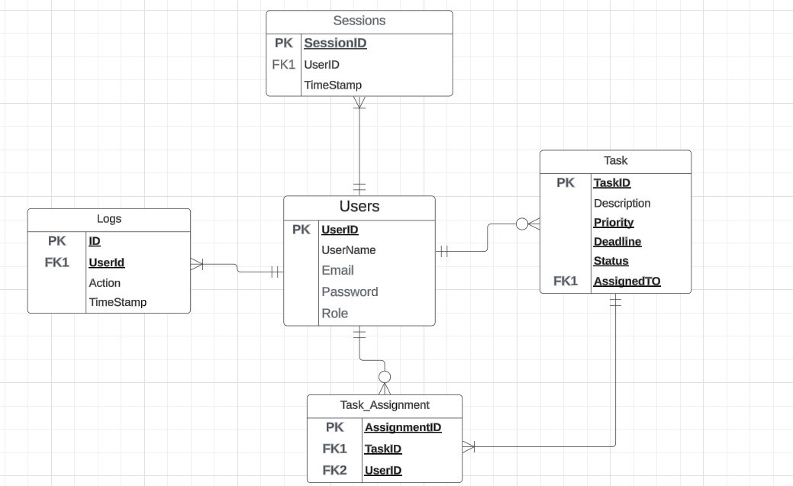
Initial Data Management Plan
Task Management: Store task details and assignments in the Tasks table, linking tasks to users for assignment and tracking; user data stored in the Users table manages task assignment permissions.
Collaboration: User data includes team member information, enabling collaboration features such as task assignment; task assignments link tasks to users for collaboration by assigning tasks to team members.
Security: User authentication data, including usernames and encrypted passwords, is stored in the Users table for secure authentication; session logs, containing login/logout timestamps and actions performed, are recorded in the Session Logs table for security auditing.

Slide 9
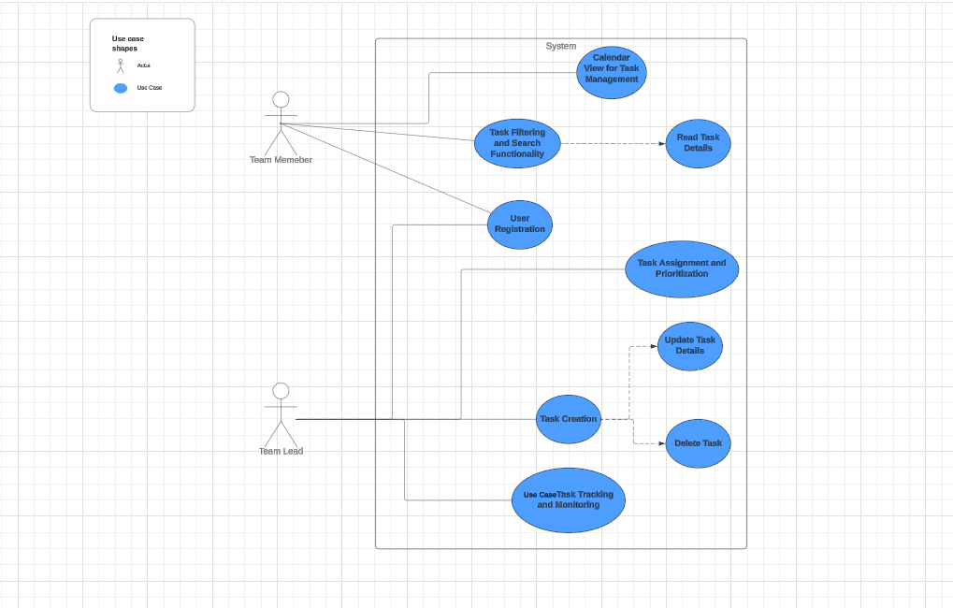
Use Cases

Slide 10
What has been accomplished?
Requirements: We have determined the Functional and Non-Functional requirements our project must have (e.g., creating a Task and assigning it to the team members).
Use Cases: We have documented actual use cases for our project so that we are aware of the features that should be included.
Data Plan: We've developed a plan for keeping track of all the data, such as Task information or User information, that our project will require.
Lessons learned till now
Creating the roadmap taught us the importance of setting clear project goals and defining its scope, providing a clear direction for our efforts.
Learning the significance of clear and effective communication among team members to facilitate collaboration, address issues, and maintain project momentum.
Understanding the importance of selecting the right technologies for the project to ensure scalability, flexibility, and security.
Understanding the importance of aligning project deliverables and outcomes with client expectations to ensure client satisfaction and project success.

Slide 11
Thank you
Team:
Harichaithanya Kotapati (S567067)
Teja Kumar Muppala (S565960)
Manichandra Kuntala (S565945)
LaxmiNarayana Yadav Pakanati (S564223)
Vaishnavi Inturi (S567121)

